Slide 1
Sleep Disorder prediction
Anastasia Talia Dwimantari

Slide 2
Table of contents
01
02
03
04
Business
Understanding
Data
Understanding
Data
Preparation
Exploratory Data Analysis
05
06
07
08
Preprocessing
Modelling
Evaluation
Insight
&
Recommendation

Slide 3
Introduction
Many of us in our working age often overlook the importance of maintaining a healthy lifestyle. However, sleep plays a crucial role in our overall health and well-being. Factors such as a balanced diet, regular exercise, and managing stress levels can significantly enhance the quality of our sleep, which is essential for maintaining heart health.

Slide 4
01
`Business Understanding`

Slide 5

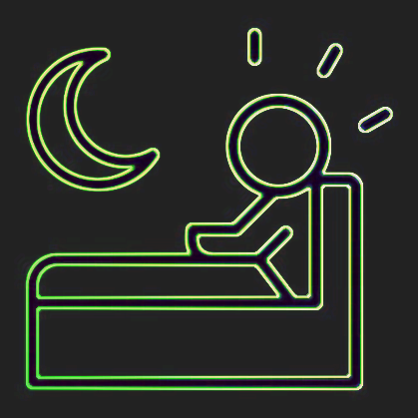
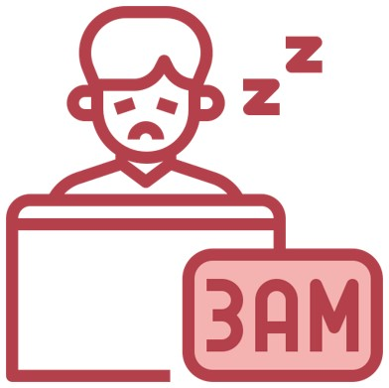
Background
Sleep Apnea
None
Insomnia
What exactly are sleep disorders?
"In simple terms, sleep disorders refer to conditions that arise from unhealth sleeping habits and lifestyles.
Why are sleep disorders considered dangerous?
Sleep is crucial for maintaining our overall health and well-being. Neglecting proper sleep and leading an unhealthy lifestyle can lead to various health issues."
in fact, research from the National Heart, Lung, and Blood Institute of the National Institutes of Health reveals that between 50 to 70 million American adults struggle with irregular sleep patterns or suffer from sleep disorde﻿rs such as insomnia and sleep apnea. This highlights a widespread issue in our society.

Slide 6
Business Goals
Challenge
Results
Solution
Identify the Factors that influence sleep health and lifestyle to detect signs of sleep disorders
Predict the likelihood of individuals experiencing sleep disorders based on their sleep health and lifestyle informatian.
Identifying and addressing sleep-related issues. Particularly within the healthcare sector.
Found the factors that cause sleep disorders
Get the best model to predict Sleep Disorders
Reduce the rate of Sleep Disorder with various health campaigns
Create an application that makes it easier to check sleep disorders

Slide 7
02
`Data Understanding`

Slide 8
Sleep Disorders Classification
01
03
02
None
Insomnia
Sleep Apnea
no signs of disease
a sleep disorder where people have trouble sleeping
a potentially serious sleep disorder in which breathing repeatedly stops and starts

Slide 9
https://www.kaggle.com/datasets/uom190346a/sleep-health-and-lifestyle-dataset/data
374 rows and 13 columns
Dictionary, next page

Slide 10
METADATA
Person ID: An identifier for each individual.
Gender: The gender of the person (Male/Female).
Age: The age of the person in years.
Occupation: The occupation or profession of the person.
Sleep Duration (hours): The number of hours the person sleeps per day.
Quality of Sleep (scale: 1-10): A subjective rating of the quality of sleep, ranging from 1 to 10.
Physical Activity Level (minutes/day): The number of minutes the person engages in physical activity daily.
Stress Level (scale: 1-10): A subjective rating of the stress level experienced by the person, ranging from 1 to 10.
BMI Category: The BMI category of the person (e.g., Underweight, Normal, Overweight).
Blood Pressure (systolic/diastolic): The blood pressure measurement of the person, indicated as systolic pressure over diastolic pressure.
Heart Rate (bpm): The resting heart rate of the person in beats per minute.
Daily Steps: The number of steps the person takes per day.
Sleep Disorder: The presence or absence of a sleep disorder in the person (None, Insomnia, Sleep Apnea).

Slide 11
03
`Data Preparation`

Slide 12


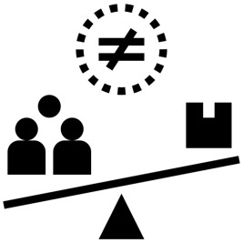
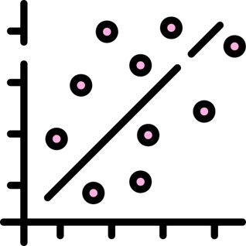
Encoding
Data Cleansing
Imbalance & Standardization
Correlation Analysis
Separating Into Numeric and Categorical Data.
Checking Data types
Checking missing handling value (null and duplicated value)
Univariate amd Bivariate Analysis
Manual Mapped
Label Encoder for data more than two categories
Oversampling with SMOTE
Min Max Scaller for Dataset with bigger range
Split Dataset into train and test data
using correlation Headmap to eliminate high correlation variable

Slide 13
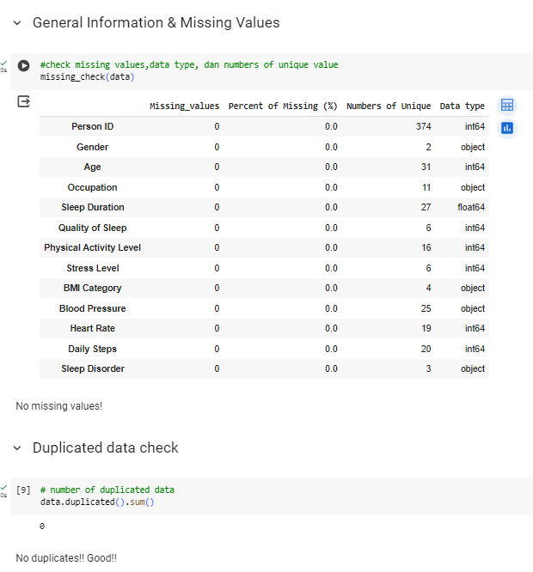
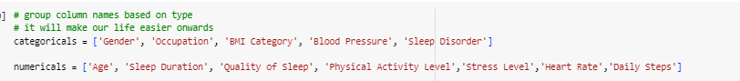
Data Cleansing

Slide 14
04
`Exploratory Data Analysis`

Slide 15
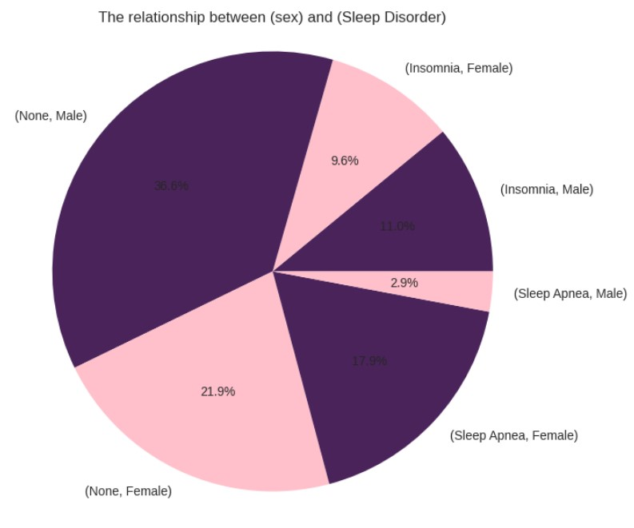
Exploratory Data Analysis I
How does Sleep Disorder by Gender compare?
it appears that females experience a significantly higher prevalence of sleep apnea, with an incidence increase of 17.9% compared to males. On the other hand, males tend to have a higher prevalence of insomnia by 11%, although this difference is not statistically significant compared to females. Therefore, it can be concluded that females are more susceptible to experiencing sleep disorders, including both sleep apnea and insomnia.

Slide 16
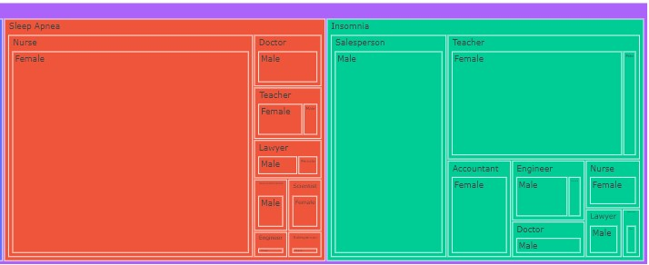
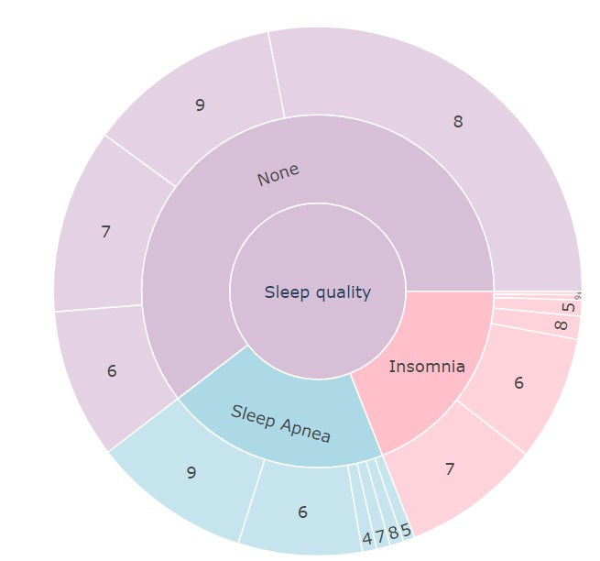
Exploratory Data Analysis II
How occupation affects Sleep Disorder?
How is the Quality of Sleep with Sleep Disorder?
Sleep Apnea has sleep quality that affects sleep duration more than Insomnia, although not significantly
1. Insomnia is most prevalent among salespersons, with 29 cases.
2. The majority of Sleep Apnea cases occur in nurses, totaling 61 individuals.
3. The highest prevalence of None cases is among doctors, with 62 individuals.

Slide 17
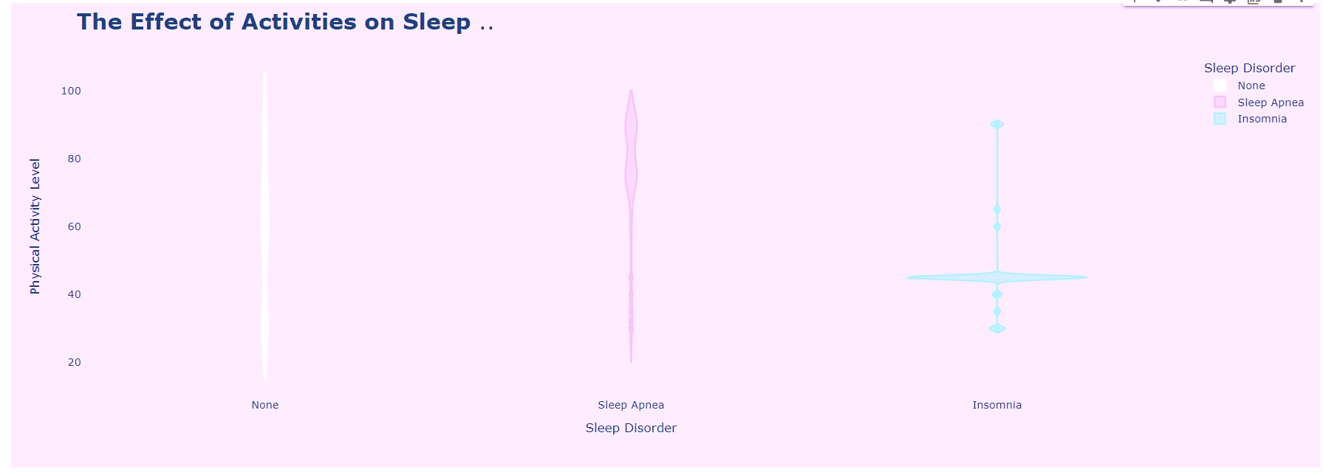
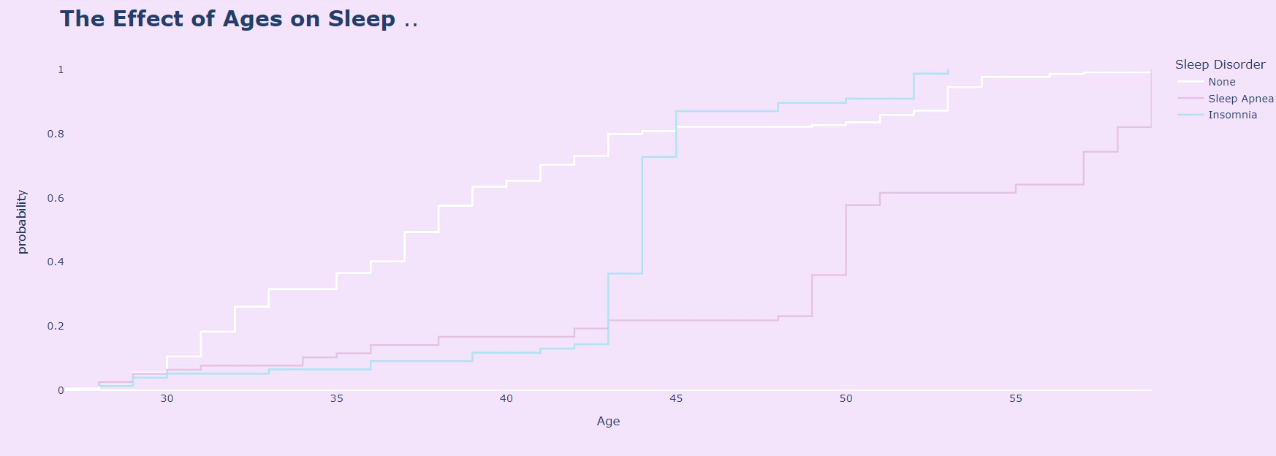
Exploratory Data Analysis III
How does Physical Activity level relate to Sleep Disorder?
See! Individuals engaging in 60-90 minutes of physical activity per day are inclined to experience Sleep Apnea, whereas those engaging in 45 minutes of physical activity per day are more prone to Insomnia.
How does age relate to Sleep Disorder?
OK, we can observe a pattern in individuals aged over 44 years old. Insomnia tends to occur more frequently, while Sleep Apnea becomes more prevalent at ages 50 years and above.

Slide 18
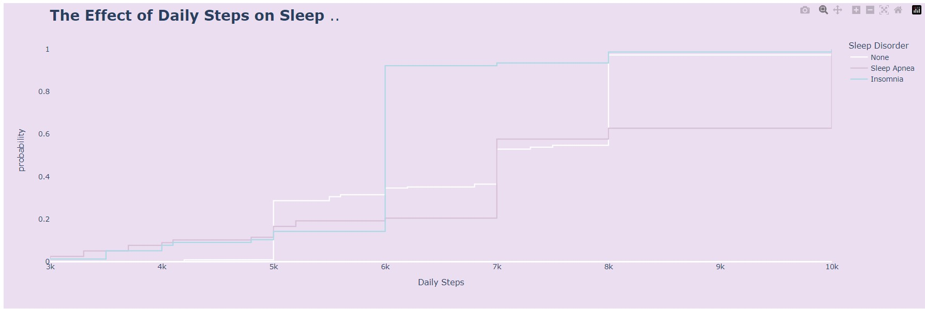
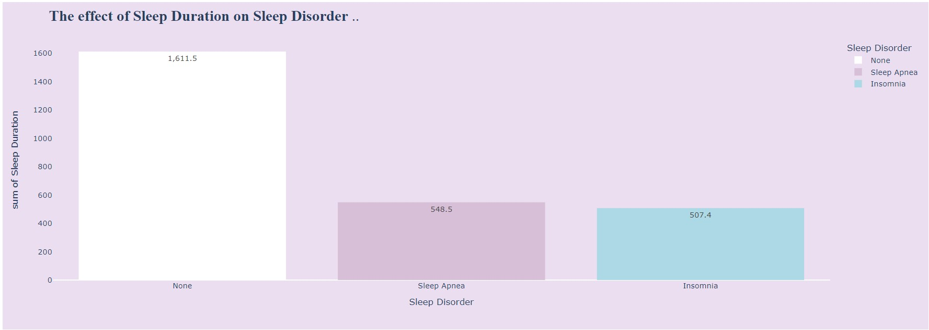
Exploratory Data Analysis IV
How is Daily Steps related to Sleep Disorder?
See! The Daily Steps pattern for Sleep Apnea increases significantly when it's around 6000 steps, whereas for Daily Steps in Insomnia, there isn't much of a difference; it only increases slightly when it's around 7000 steps per day.
How does Sleep Duration relate to Sleep Disorder?
Interestingly, the sleep quality patterns of Sleep Apnea and Insomnia differ significantly, nearly 50%, compared to those with None. This suggests that individuals with both conditions may experience poor sleep duration.

Slide 19
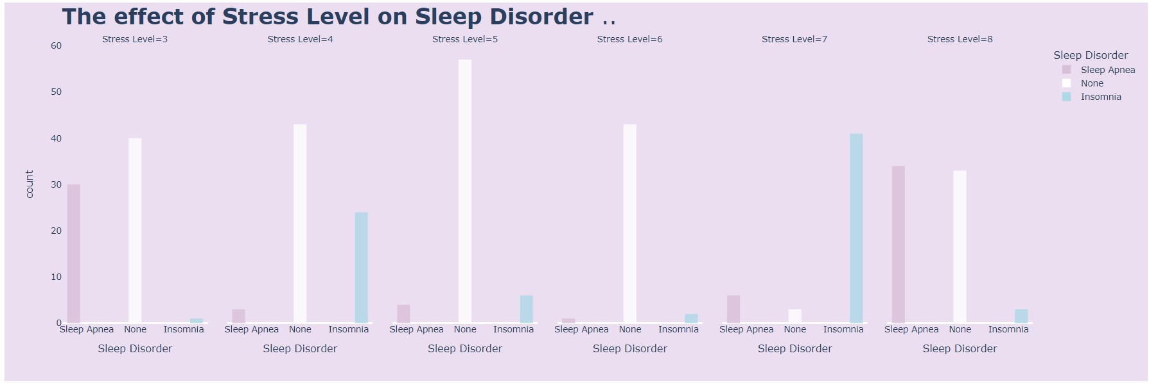
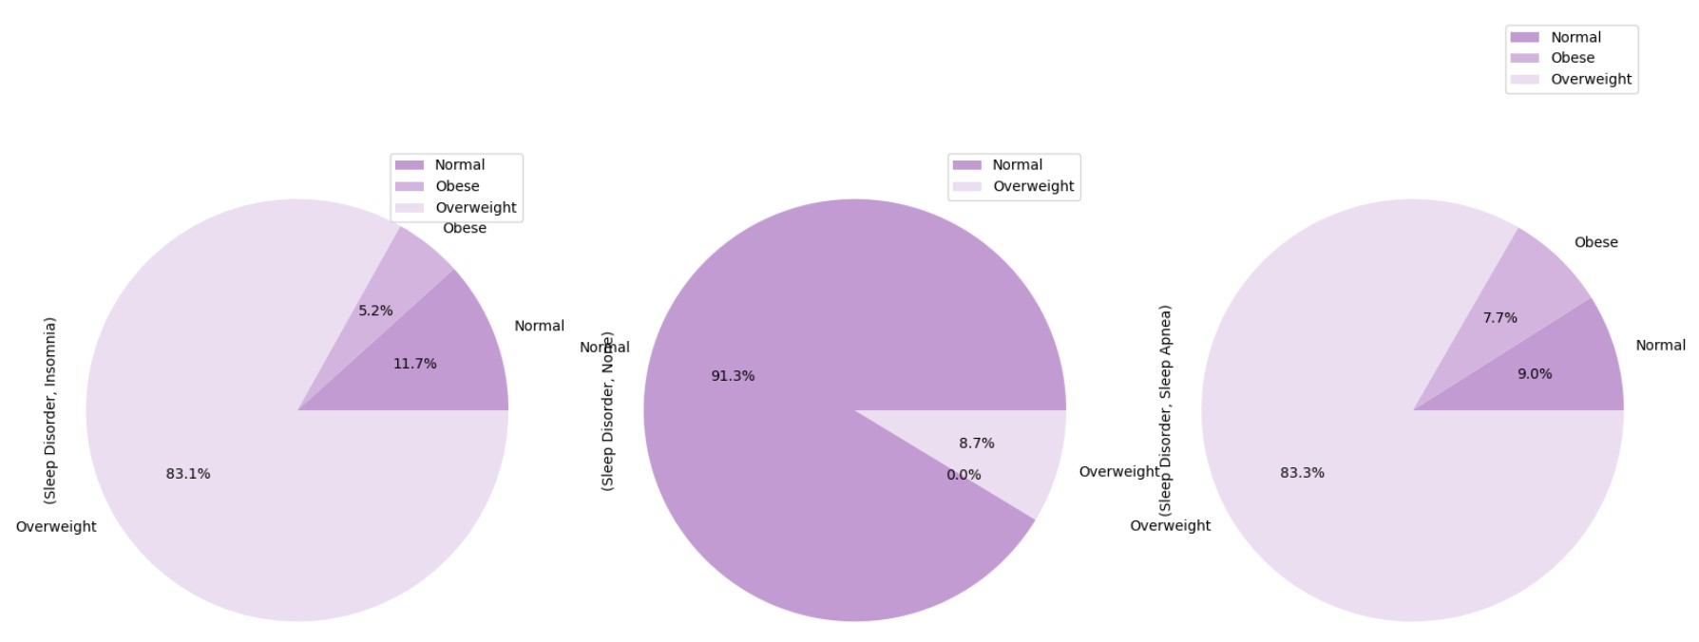
Exploratory Data Analysis V
How is Stress Level related to Sleep Disorder?
High stress levels (7-8) significantly contribute to the occurrence of insomnia and sleep apnea, while even moderate stress levels (3-4) can predispose individuals to experience these sleep disorders.
How is BMI Category related to Sleep Disorder?
Evidently, individuals classified as 'overweight' have the highest prevalence of both Sleep Apnea and Insomnia. For those with 'Normal' BMI, Insomnia occurs slightly more than Sleep Apnea, albeit insignificantly. Similarly, among 'Obese' individuals, Sleep Apnea is slightly more prevalent than Insomnia, yet not significantly so.

Slide 20
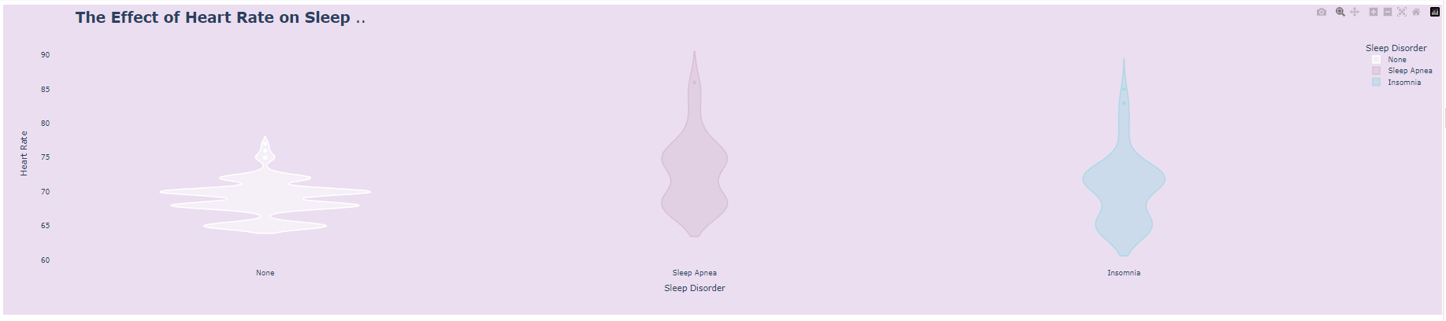
Exploratory Data Analysis VI
How is Heart Rate related to Sleep Disorder?
It was discovered that individuals with the highest heart rate tend to experience Sleep Apnea, although the difference with Insomnia is not significant. Both conditions exhibit the highest heart rate in the range of 68-75, with Insomnia peaking at 72.

Slide 21
05
`Preprocessing`

Slide 22
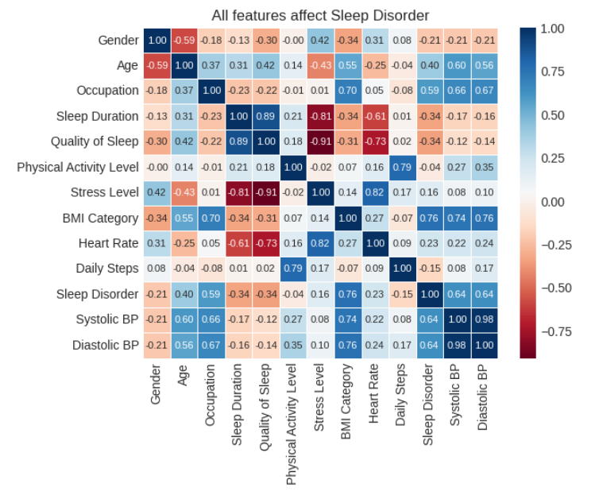
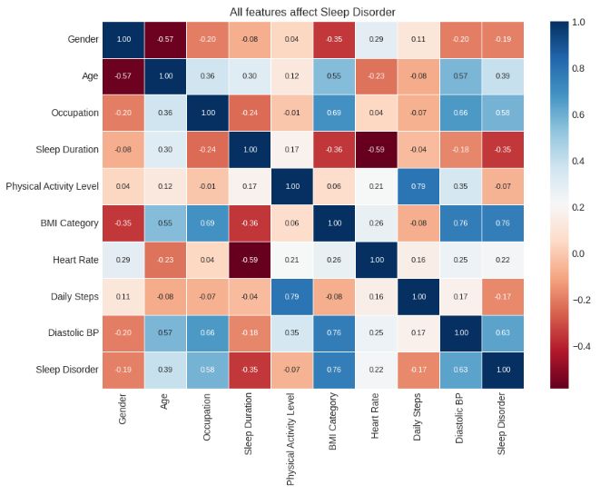
FOUND !!
correlation + Quality of sleep with Sleep Duration
correlation + Stress Level with Heart Rate
correlation + Systolic and diastolic
Correlation - Quality of Sleep with Stress Level
Correlation - Sleep Duration with Stress Level
SO, WE ARE DROP :
QUALITY OF SLEEP , STRESS LEVEL , SYSTOLIC BP
AFTER DROP REDUNDANT
BEFORE DROP REDUNDANT

Slide 23
06
`Modelling`

Slide 24
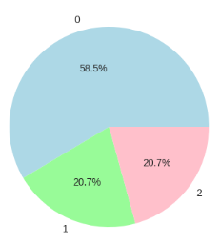
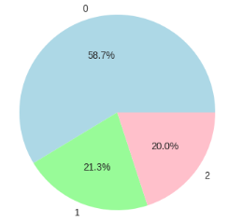
Factors to consider
The train and test results show no significant differences
Train Distribution
Test Distribution
In this case, the metric I will use is the RECALL SCORE, given that the target data is imbalanced. I opted for recall because my goal is to ensure that the model is sensitive to potential cases of sleep disorders, encompassing both Sleep Apnea and Insomnia.

Slide 25
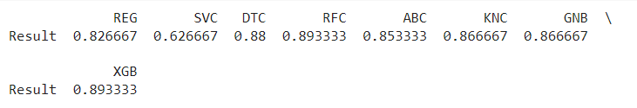
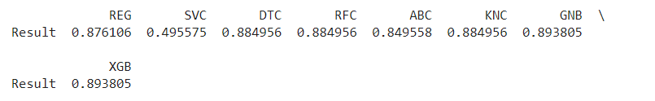
Factors to consider
RECALL SCORE BASELINE MODEL
AFTER OVERSAMPLING(SMOTE METHOD)
THE BEST MODEL “ GaussianNB & XGBoost ”

Slide 26
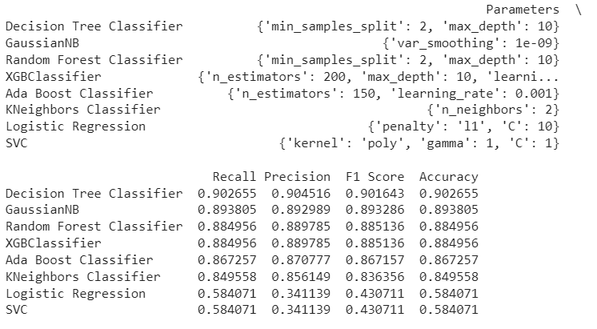
Factors to consider
AFTER HYPERPARAMETER TUNING with RANDOMIZEDSEARCHCV FOR AVOID OVERFITTING

Slide 27
07
`EVALUATION`

Slide 28
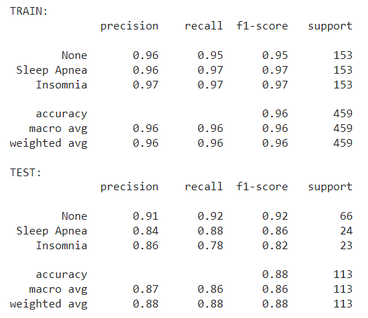
Decision Tree Classifier
THERE IS A DECREASE IN THE PRECISION, RECALL AND F-1 VALUE FROM TRAIN MODEL TO TEST WHICH INDICATES THAT THE DATA PREPROCESSING CARRIED OUT IS CORRECT.
There is no significant difference between Train and Test data, which indicates that the data is not overfitting.
RECALL FOR NONE: 0.92 (92% OF ACTUAL NONES ARE ALMOST COMPLETELY CAPTURED BY THE GBC MODEL)
RECALL FOR SLEEP APNEA: 0.88 (88% OF THE ACTUAL SLEEP APNEA INSTANCES WERE CAPTURED BY THE MODEL)
RECALL FOR INSOMNIA: 0.78 (78% OF THE ACTUAL INSOMNIA INSTANCES WERE CAPTURED BY THE MODEL)

Slide 29
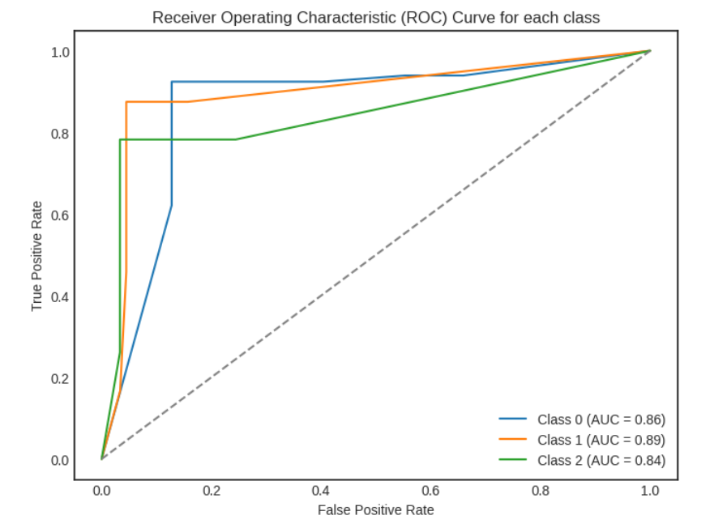
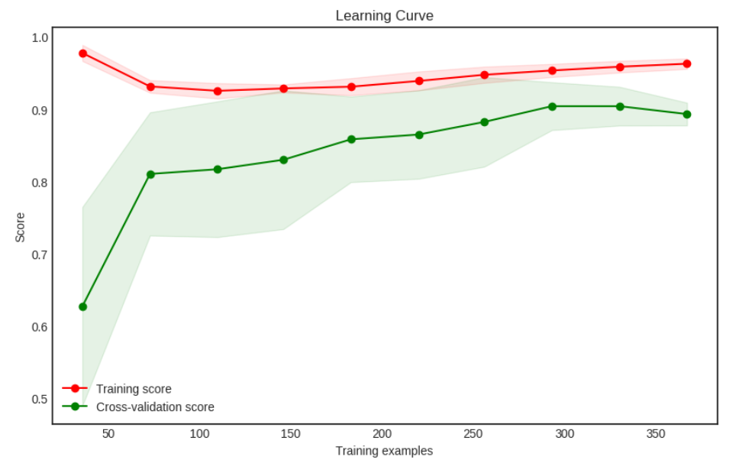
Decision Tree Classifier
From the ROC-AUC curve and Learning Curve, the results of the Decision Tree Classifier Model look good, so even though the Recall values between Train and Test Data are slightly different, this does not indicate overfitting.

Slide 30
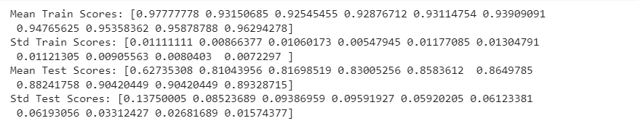
Decision Tree Classifier
From the results of the standard deviation of the train and test data, it can be seen that there is a significantly higher difference, namely the test data, but with the addition of training, the standard deviation in the test becomes smaller.

Slide 31
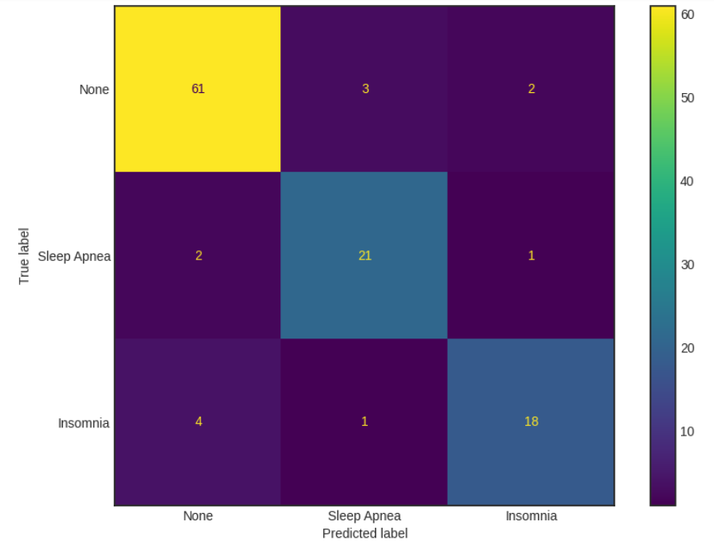
Decision Tree Classifier
WE CAN SEE THAT A 3 X 3 CONFUSION MATRIX IS GENERATED:
*ROW 1, WE SEE THAT OUT OF THE 66 TOTAL (61+3+2) NONE DATA POINTS, 61 OF THEM WERE PREDICTED CORRECTLY. 3 TEST POINTS WERE INCORRECTLY CLASSIFIED AS SLEEP APNEA AND 2 TEST POINT WAS INCORRECTLY CLASSIFIED AS INSOMNIA.
*ROW 2, WE SEE THAT OUT OF 24 TOTAL (21+2+1) SLEEP APNEA DATA POINTS, 21 OF THEM WERE PREDICTED CORRECTLY. 2 TEST POINTS WERE INCORRECTLY CLASSIFIED AS NONE AND 1 TEST POINT WAS INCORRECTLY CLASSIFIED AS INSOMNIA.
*ROW 3, WE SEE THAT OUT OF THE 23 TOTAL (18+4+1) INSOMNIA DATA POINTS, 18 OF THEM WERE PREDICTED CORRECTLY. 4 TEST POINTS WERE INCORRECTLY CLASSIFIED AS NONE AND 1 TEST POINT WAS INCORRECTLY CLASSIFIED AS SLEEP APNEA.

Slide 32

Feature Importance

Slide 33
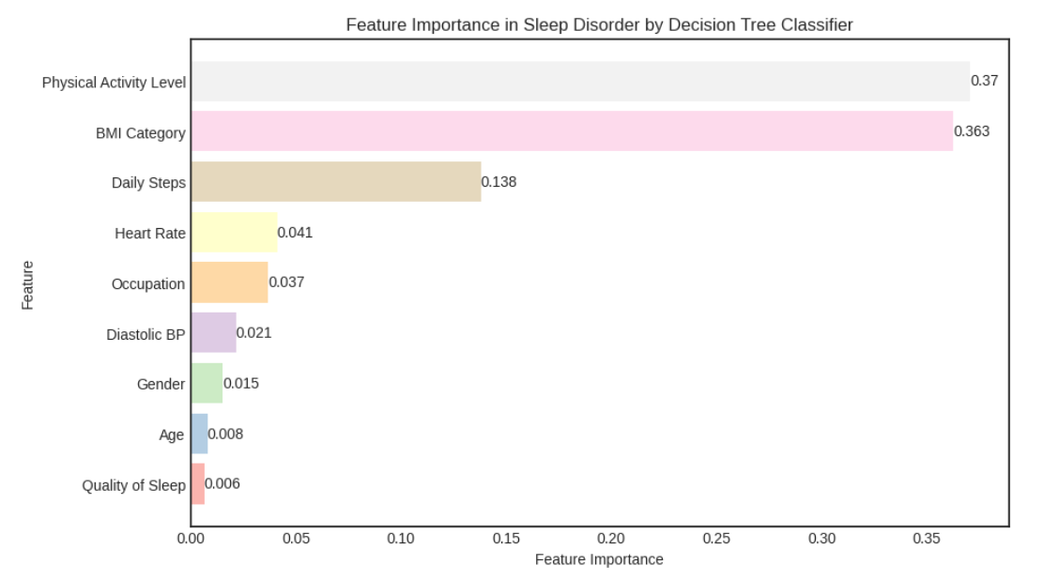
Based on the Feature Importance visualization, there are 3 features that really influence the characteristics of Sleep Disorder, namely Physical Activity Level, BMI Category and Daily Steps where these three features are very closely related to lifestyle.

Slide 34
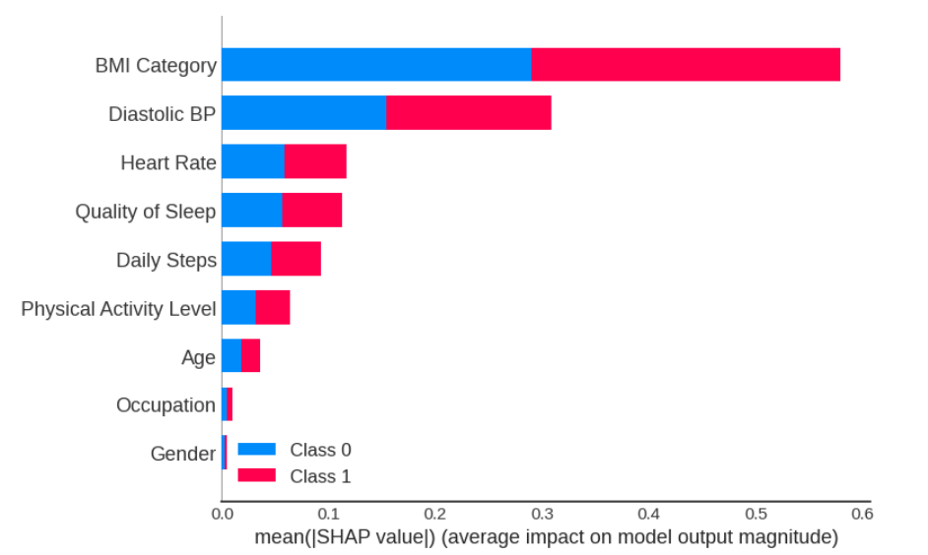
Based on the Shap Method, there are 3 features that really influence the characteristics of Sleep Disorder, namely BMI Category, Diastolic BP and Heart Rate where these three features are very closely related to Sleep Pattern.

Slide 35
08
`INSIGHT & RECOMMENDATION`

Slide 36
— Someone Famous
“This is a quote, words full of wisdom that someone important said and can make the reader get inspired”

Slide 37
Conclusions
1. are older (45 years and above).
2. work in the fields of nursing, sales, or teaching.
3. have a sleep duration ranging from 5.9 to 8.3 hours.
4. have a total sleep duration of less than 1000 hours.
5. engage in physical activity levels around 60-90 minutes, making them susceptible to Sleep Apnea, or around 45 minutes, making them susceptible to Insomnia.
6. experience stress levels between 3-4 and 7-8.
7. fall into the overweight BMI category.
8. have a heart rate above the normal range of 80.
9. take fewer than 10000 steps per day.
10. have high blood pressure, with readings above 120/80.

Slide 38
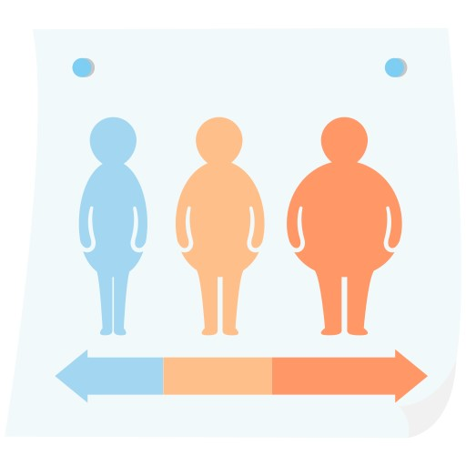


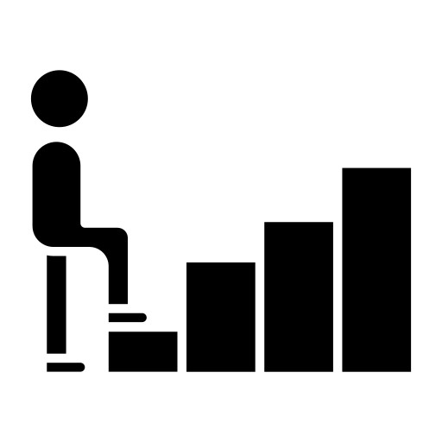

RECOMMENDATION
BY CONSIDERING THE EDA DATA FOR EACH FEATURE COEFFICIENT THAT CAUSES SLEEP DISORDER AS WELL AS THE FEATURES SELECTION DATA FOR THE BEST MODEL, IT IS RECOMMENDED THAT NATIONAL HEALTH FOCUS ON:
HOLDING SPORTS TOGETHER, SUCH AS SMALL TO LARGE SCALE RUNNING.
National Health collaborates with companies to appreciate individuals who actively lead a healthy lifestyle, including managing their weight and consuming nutritious food so that this pattern can influence BMI and blood pressure.

Slide 39
RECOMMENDATION
HEALTH CAMPAIGNS THAT EMPHASIZE THE IMPORTANCE OF WELL-BEING. Health initiatives that target sleep patterns, especially in age groups that are vulnerable to sleep disorders.
Maintaining good health among workers makes a significant contribution to a company's ability to achieve its goals.
Collaboration between National Health authorities and companies can facilitate the implementation of Work-from-Home (WFH) or Work-from-Anywhere (WFA) systems, thereby encouraging a healthier work-life balance for employees.
By managing their activities effectively, residents/workers have the potential to reduce the prevalence of sleep disorders such as Sleep Apnea and Insomnia by up to 40% compared to previous years.
Overcoming sleep disorders can be done if individuals realize the importance of health, not only for themselves but also for their families and other people.

Slide 40
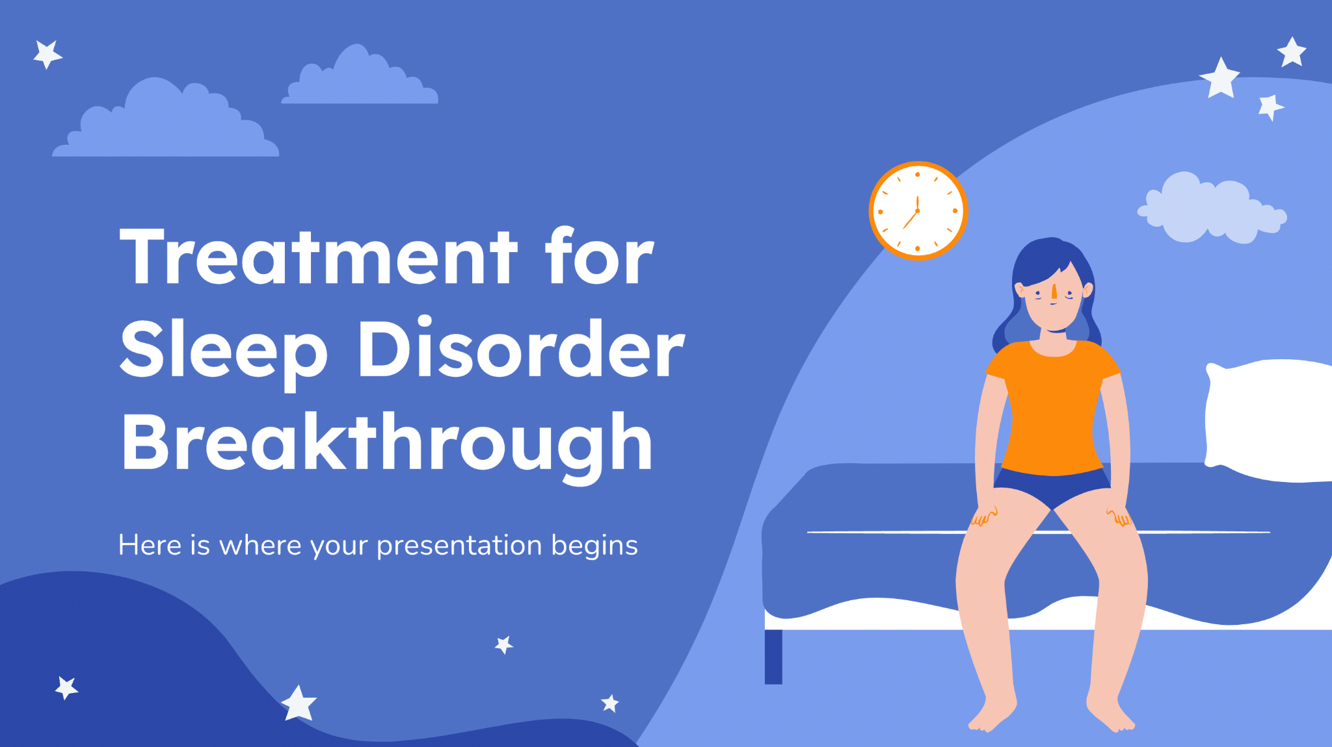
Sleep Wellness Program Business
DTC Corporation is a healthcare technology company focused on improving the well-being of individuals through innovative solutions. Leveraging data analytics and behavioral science, DTC Corporation aims to address sleep disorders and promote better sleep habits among its users.
Initiative: DTC Corporation launches a Sleep Wellness Program targeted at individuals suffering from insomnia. The program utilizes personalized sleep coaching, guided meditation sessions, and access to sleep tracking tools through a mobile application.

Slide 41
Business Impact
100,000
60,000
This is the number of total visitors we had last month
This is the number of patients we had last month

Slide 42
Thanks!
Do you have any questions?
anastasiadwimantari@gmail.com
https://github.com/naslita
Please keep this slide for attribution

Slide 43
Research resources
HTTPS://WWW.HEART.ORG/EN/HEALTH-TOPICS/HIGH-BLOOD-PRESSURE/UNDERSTANDING-BLOOD-PRESSURE-READINGS
HTTPS://WWW.NCOA.ORG/ADVISER/SLEEP/SLEEP-APNEA-STATISTICS/
HTTPS://WWW.CDC.GOV/PHYSICALACTIVITY/BASICS/ADULTS/INDEX.HTM
HTTPS://MEDIUM.DATADRIVENINVESTOR.COM/THE-BASICS-OF-DECISION-TREES-E5837CC2ABA7
HTTPS://MEDIUM.COM/ANALYTICS-VIDHYA/CLASSIFICATION-IN-DECISION-TREE-A-STEP-BY-STEP-CART-CLASSIFICATION-AND-REGRESSION-TREE-8E5F5228B11E
HTTPS://WWW.MAYOCLINIC.ORG/HEALTHY-LIFESTYLE/FITNESS/EXPERT-ANSWERS/HEART-RATE/FAQ-20057979#:~:TEXT=A%20NORMAL%20RESTING%20HEART%20RATE%20FOR%20ADULTS%20RANGES%20FROM%2060,TO%2040%20BEATS%20PER%20MINUTE.

Slide 44
Resources
Icons
Time to Sleep | Flat
Fletigo
Pinterest

Slide 45


